Slide 1
DECISION REVIEW SYSTEM
BY DINESH SINGH

Slide 2
CONTENT
Introduction
Problem definition
Objective
Requirements
System Design
Snapshots

Slide 3
INTRODUCTION
On-field Umpire are unable to decide whether the player is out or not out because the situation is too close, here Decision Review System(DRS) helps.
Review System is a technology which helps to take decision by revisiting the situation we want for.
Decision Review System(DRS) often called Third Umpire Decision Review System.
Without Decision Review System(DRS) Umpire may take wrong decision

Slide 4
PROBLEM DEFINITION
When you are safe but sent out, it does discourage players and cause anger and anxiety in viewers.
A bowler or a batsman who is unsatisfied with the decision of the umpire is usually seen to be aggressive and losing all his calm in the game.
There rises sheer enmity and hatred between teams.
When people felt the umpire giving out wrong judgment and the inclusion of DRS could be a means to solve this issue.

Slide 5
OBJECTIVE
Built a Decision Review System(DRS) which helps on-field umpires to take decision whether the player is out or not out.
Control the flow of video clip so we look at the situation properly.
Take decision by analysing video clip.

Slide 6
REQUIREMENTS
SOFTWARE REQUIREMENTS
HARDWARE REQUIREMENTS
Operating System :Window/Linux/Mac
Language Used : Python
Additional Software : Photoshop
IDE : Pycharm/IDLE
CPU : Dual Core or Higher
RAM : 2 GB or Higher

Slide 7
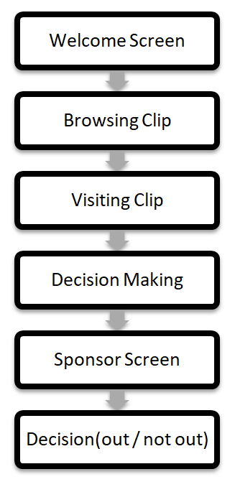
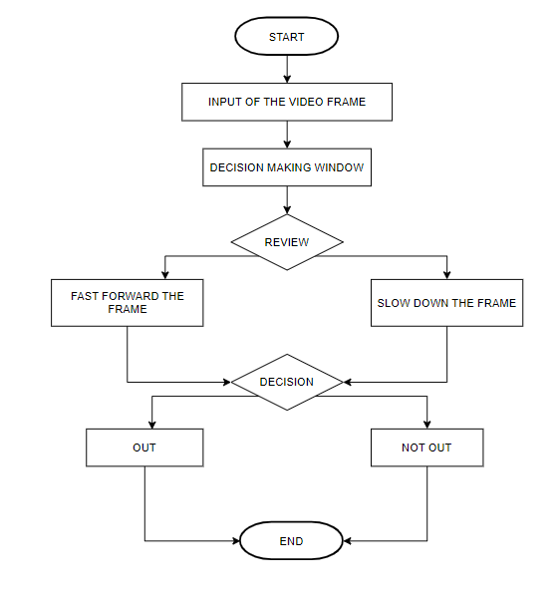
SYSTEM DESIGN

Slide 8
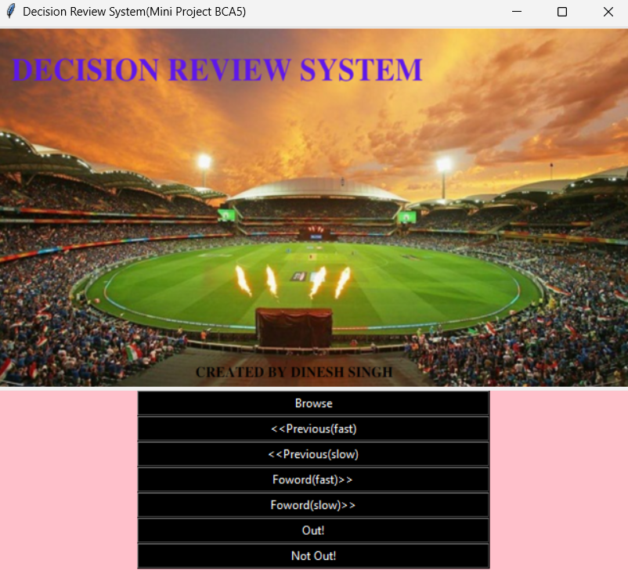
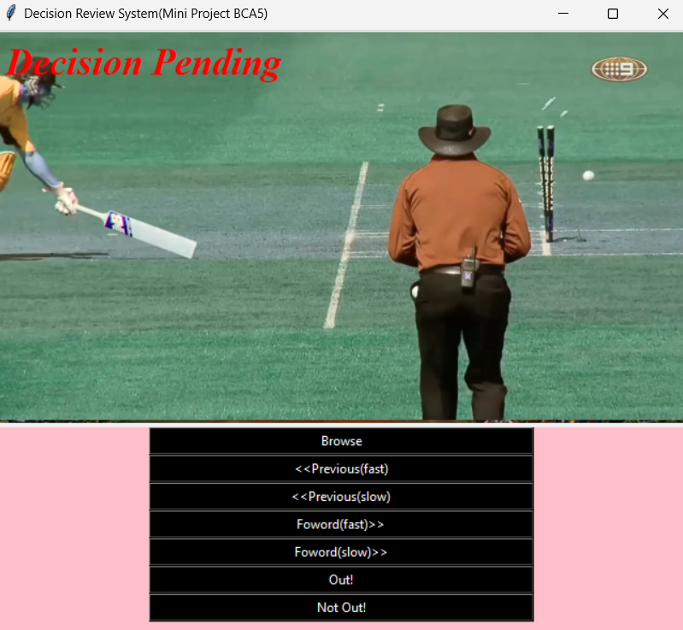
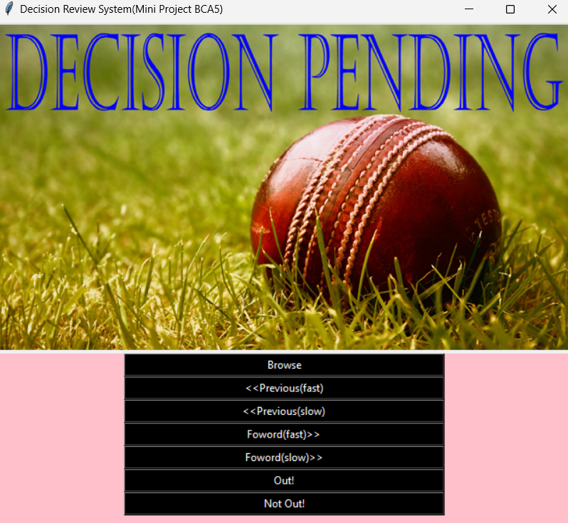
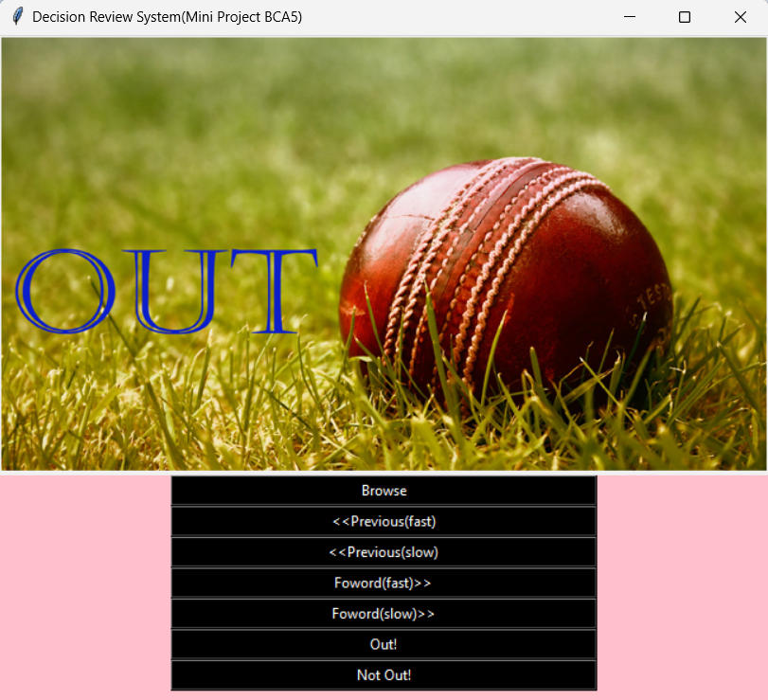
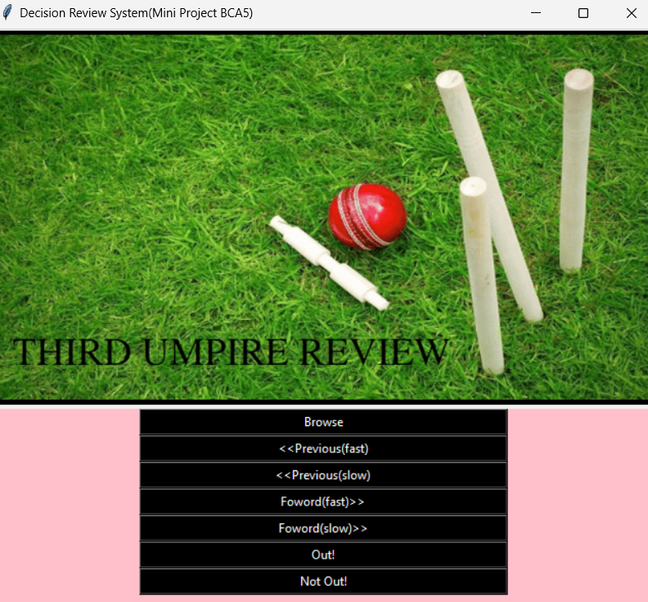
SNAPSHOTS

Slide 9
THANK YOU!

